Slide 1
Women Working Hours
Hannah Xia, Meng Wang, Prince Wang

Slide 2

Agenda
Data selection
Data description
The building process of initial model
The transformation of the model
The main effect plot
The testing process of model
The discovering of active predictors
Key insights

Slide 3
Data Selection
Reasons to choose this dataset
Response is numerical
11 predictors: 3 categorical variables, 8 numerical variables
Interested about the trend of women workforce in the future
Objectives
To figure out the relationship between these 11 predictors and the response
To find how these 11 predictors affect the response
To test the accuracy of the structured model
Notes:
This dataset has enough predictors, including both categorical variables and numerical variables
The response, women working hours, is numerical, which is good for us to predict
Interested about the trend of women workforce in the future, it is a popular topic today
People would like to know how will the women affect the world
Objective:
interesting fact between women working hours and our predictors

Slide 4
Data Description
Response
Hours: wife working hours per year
Predictor
Income: the other household income in hundreds of dollars
Age: age of the wife
Education: education years of the wife
Child5: the number of children for ages 0 to 5
Child13: the number of children for ages 6 to 13
Child17: the number of children for ages 14 to 17
Unemp: local unemployment rate in percentage
Nonwhite: non-white?
Owned: is the home owned by the household?
Mortgage: is the home on mortgage?
Occupation: occupation of the husband
Notes:
child5, child13, child17: non continuous variables, but we cannot treat as categorical
occupation: level of 4

Slide 5
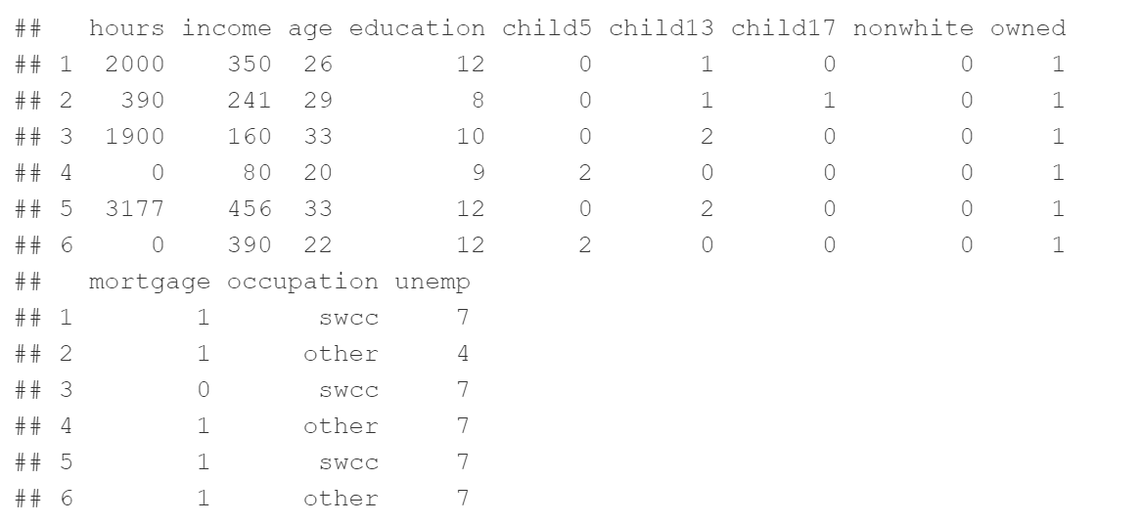
Data Desription Cont. - head
Remove all the negative and zero value in the income
Notes:
remove the negative and zero value in the income: because it makes no sense

Slide 6
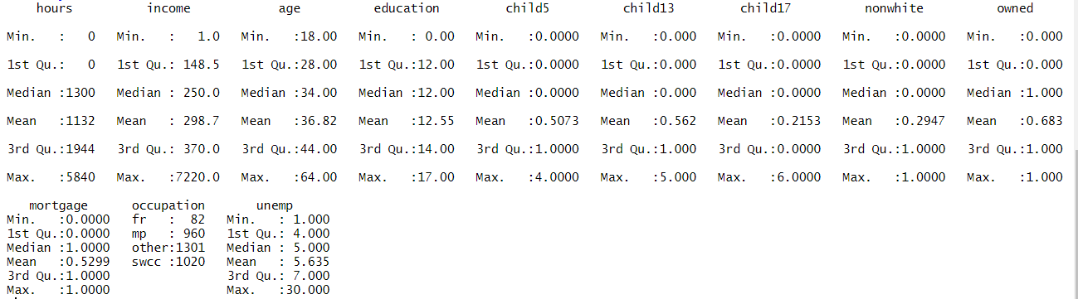
Data Desription Cont. - summary
Notes:
hours: 0, some women work zero, and some women work a lot
age: range from 18 to 64
child5, child13, child17: from median is 0, we can see most of families does not have children
we use yeo-johnson method to do transformation for the both predictors and the response, instead of box cox method, because the data are not strictly positive

Slide 7
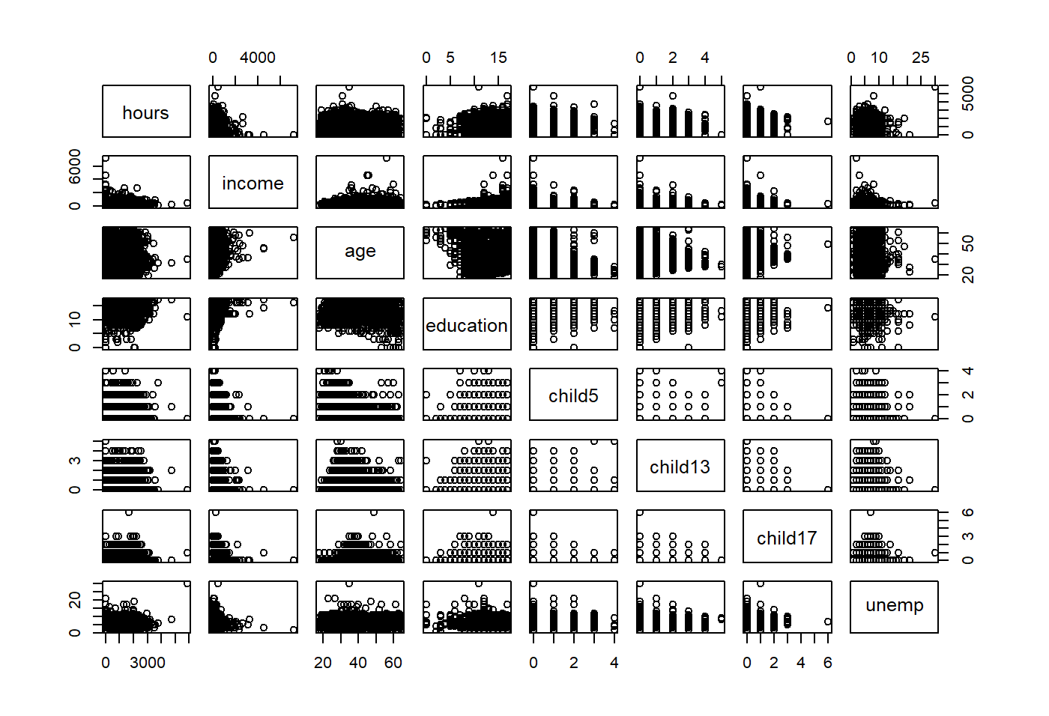
Data Description Cont. - plot
Plot numerical predictors and response to check the relationship between them
Notes:
only plot numerical variables and the response
The relationship between hours and income, more income, less working hours

Slide 8
The Building Process of the Linear Model
Initial Model with all predictors
residualPlots and qqPlots
Predictors and response transformation
Selection of predictors based on F-test
Decide on final model and interpretation
Notes:
response transformation to see the changes of r-squared
by using F-tests, we use anova table, see the p-value of each predictor,

Slide 9
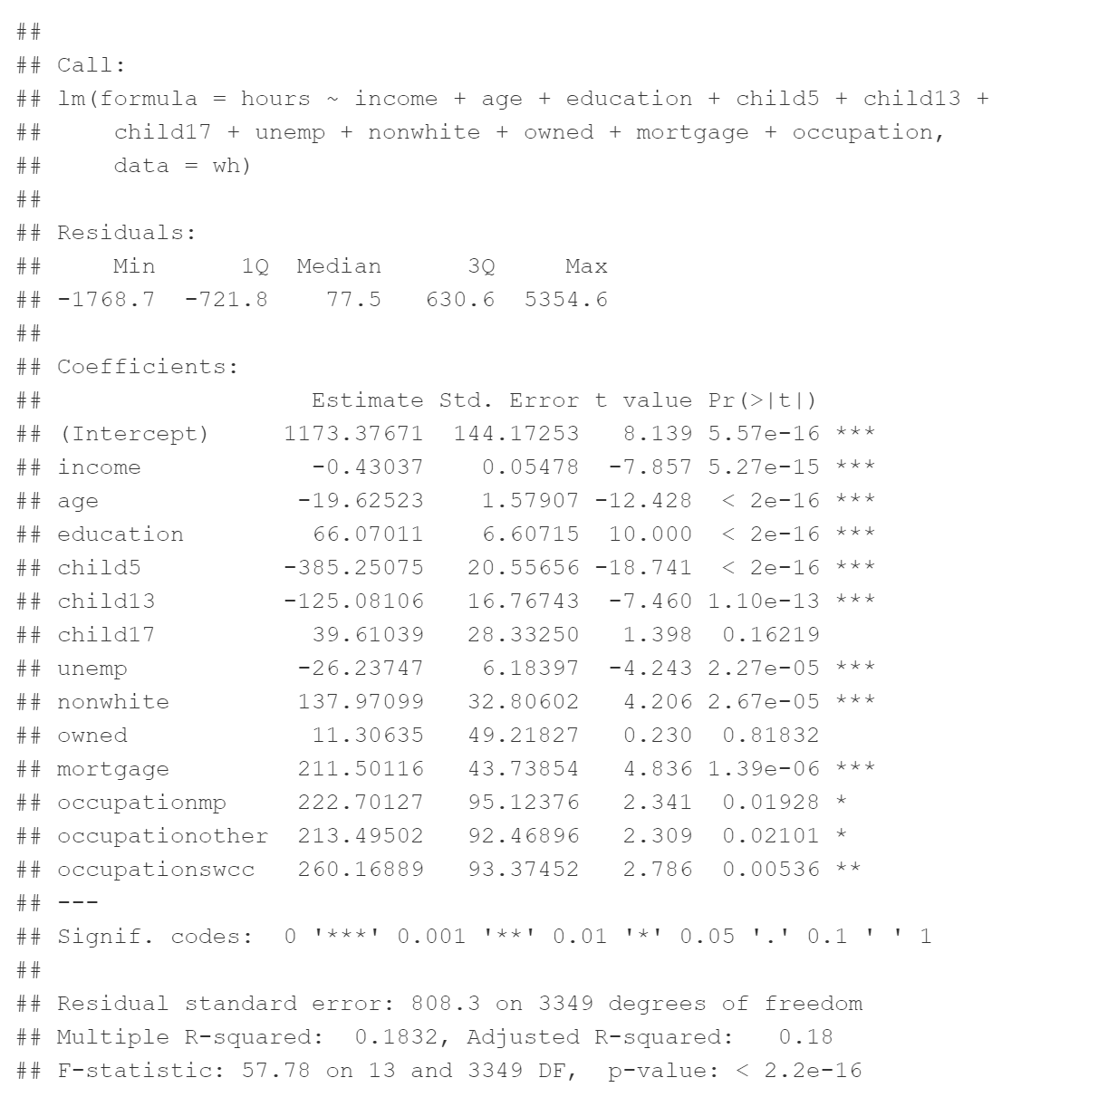
Initial Model
Build initial model with all predictors
lm0 <- lm(hours ~ income + age + education + child5 + child13 + child17 + unemp + nonwhite + owned + mortgage + occupation, data = wh)

Slide 10
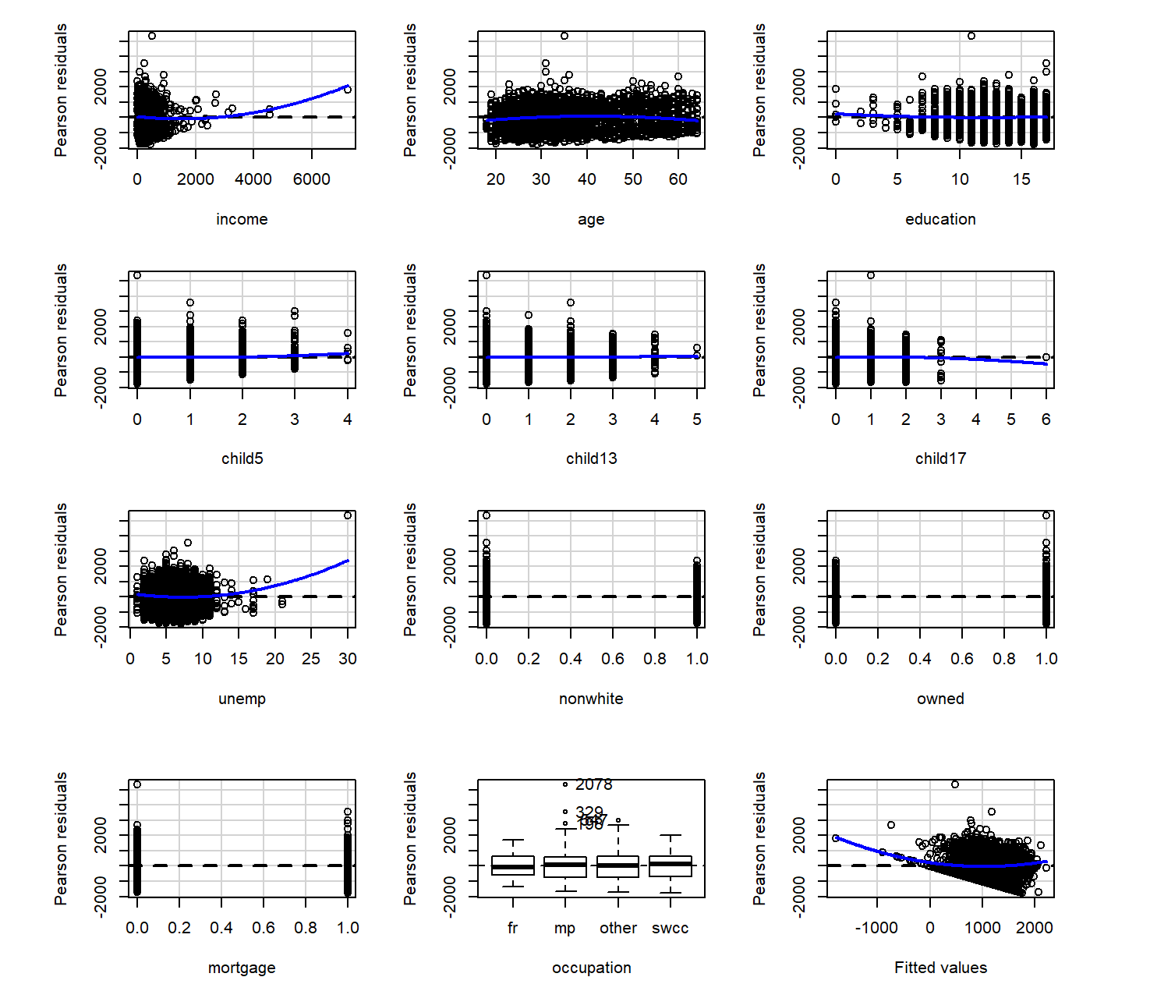
Initial Model Cont. - residualPlots
Residual plots
The lines are flat when the predictors are within normal range
Not violate any assumptions

Slide 11
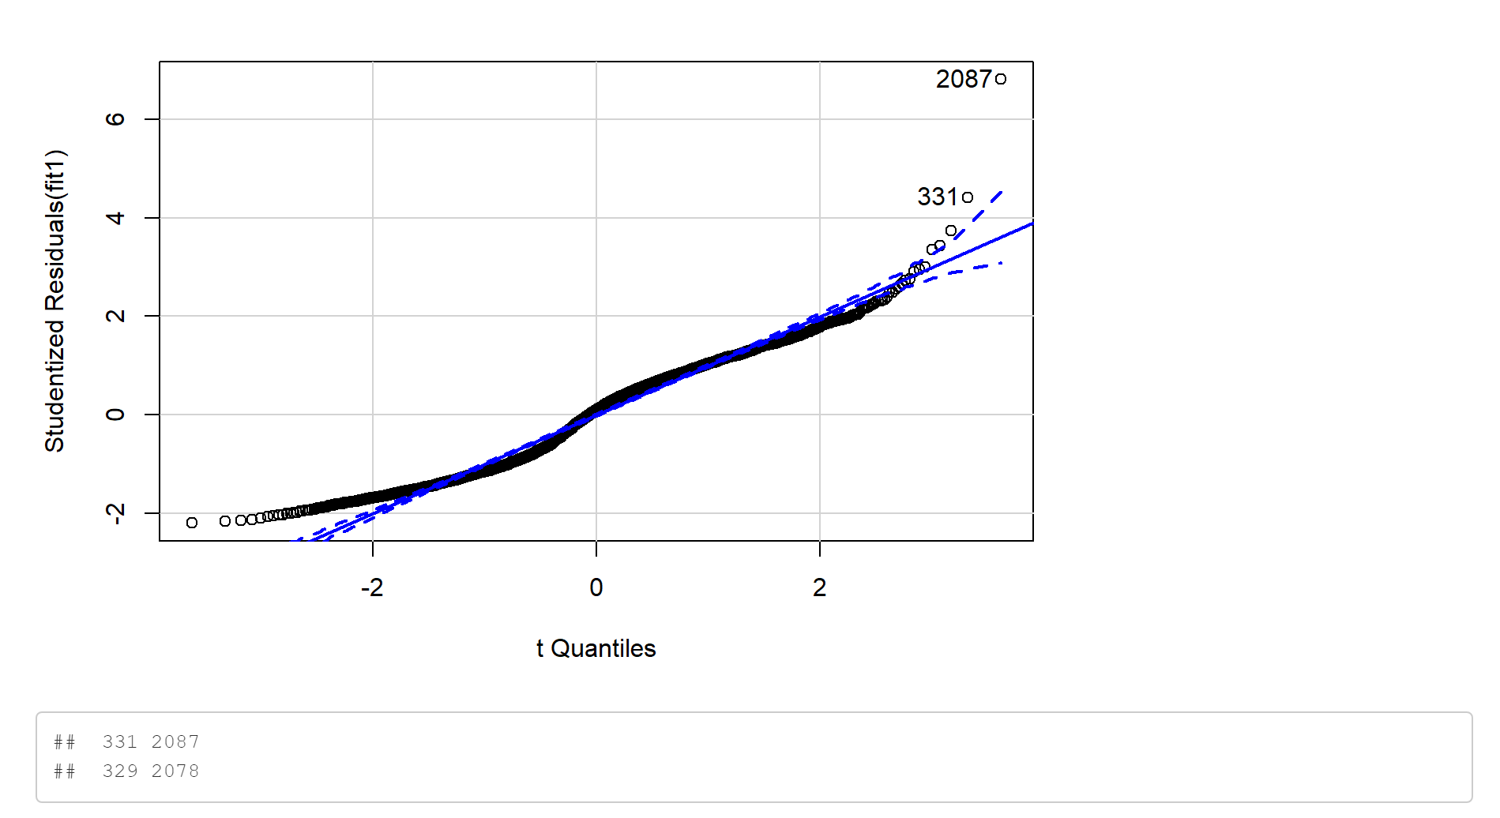
Initial Model Cont. - qqPlot
QQ plot

Slide 12
Transformation Process

Slide 13
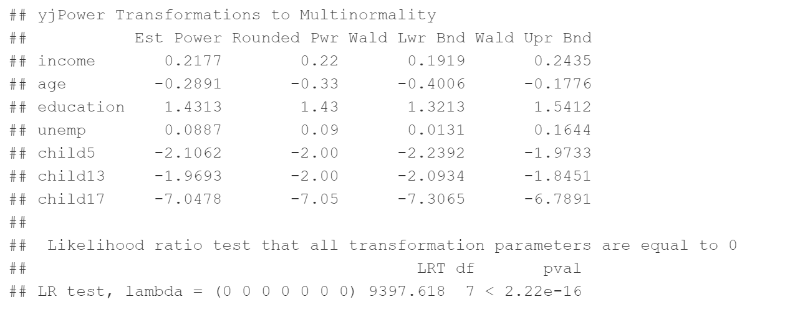
Transformation Process Cont.
Use yj power to transform the predictors

Slide 14
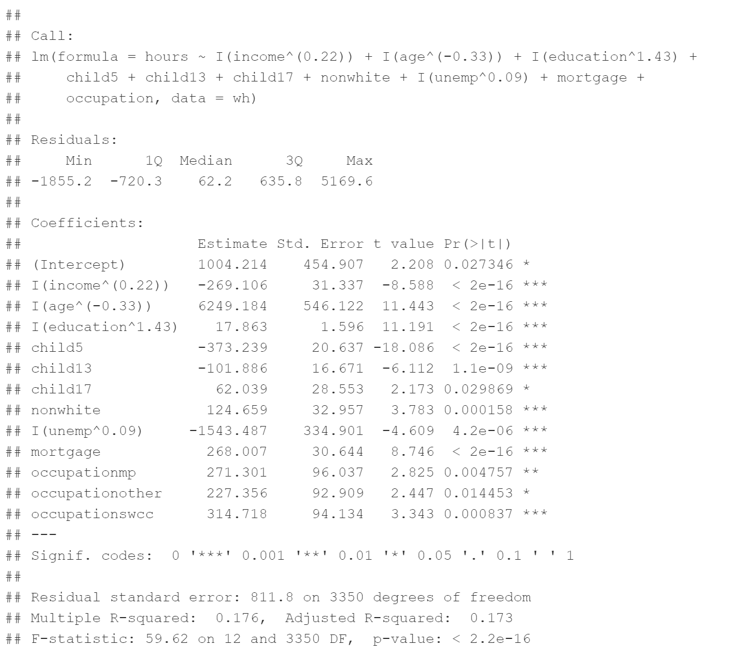
Transformation Process Cont.
Transform predictors based on yj power transformation
Since there are 0s in child5, child13, child17, we cannot use the power transformation
Lower R-sqaured: 0.176

Slide 15
Transformation Process Cont.

Slide 16
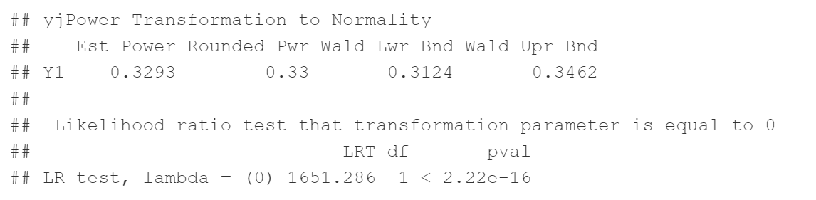
Transformation Process Cont.
Transform the response
Because there is 0 in women working hours, we choose yj power

Slide 17
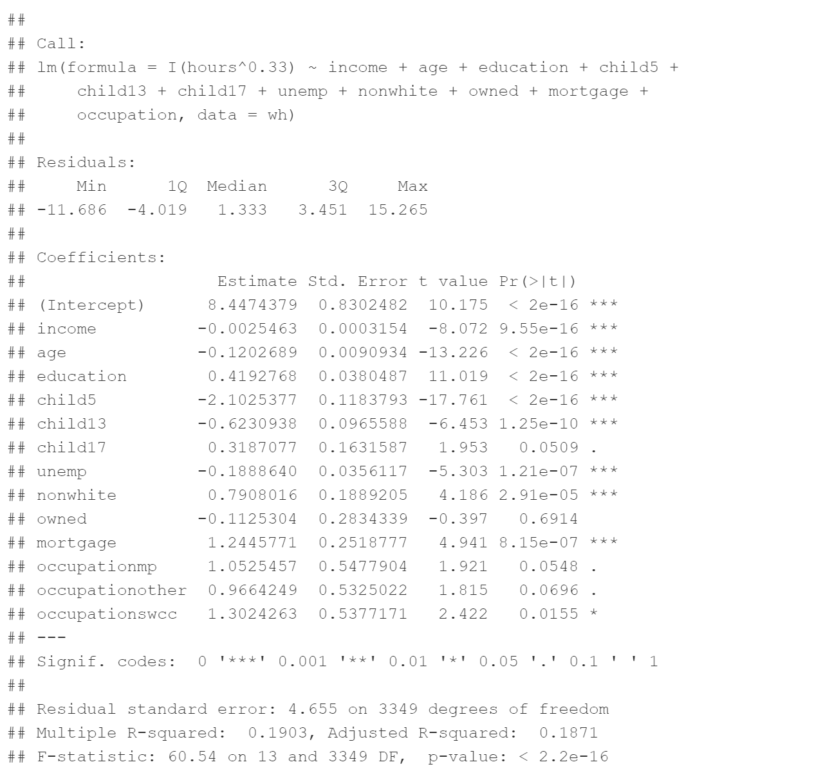
Transformation Process Cont.
Model summary with the transformed response
Higher R-squared: 0.1903
Decide to use the power transformation on the response

Slide 18
Transformation Process Cont.

Slide 19
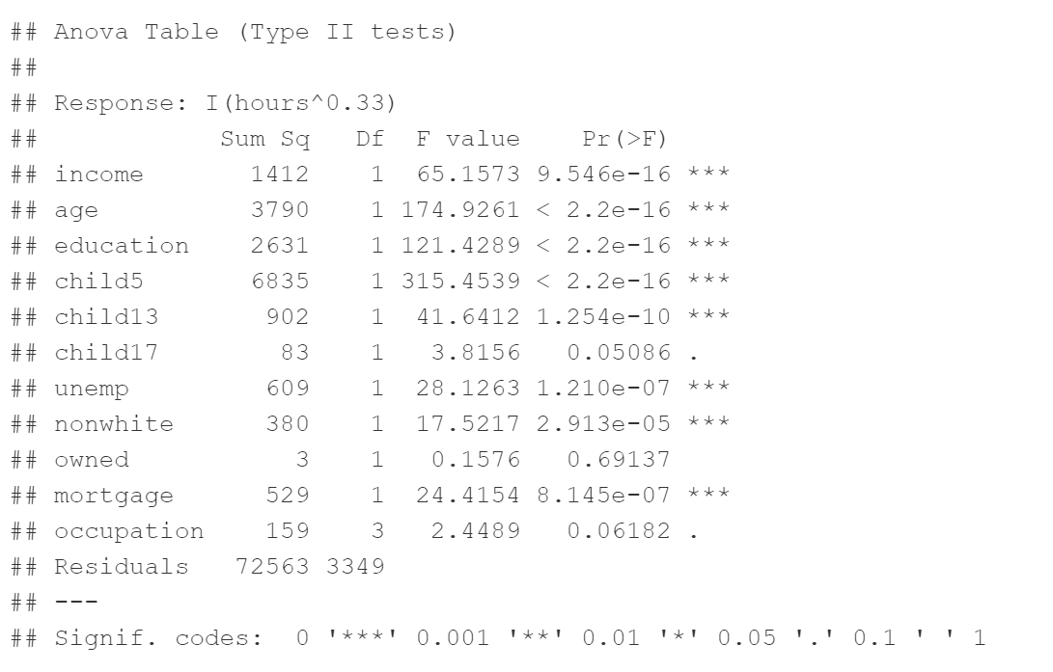
Transformation Process Cont.
Large P value for the child17, owned, and occupation
Accept the NH for these predictors

Slide 20
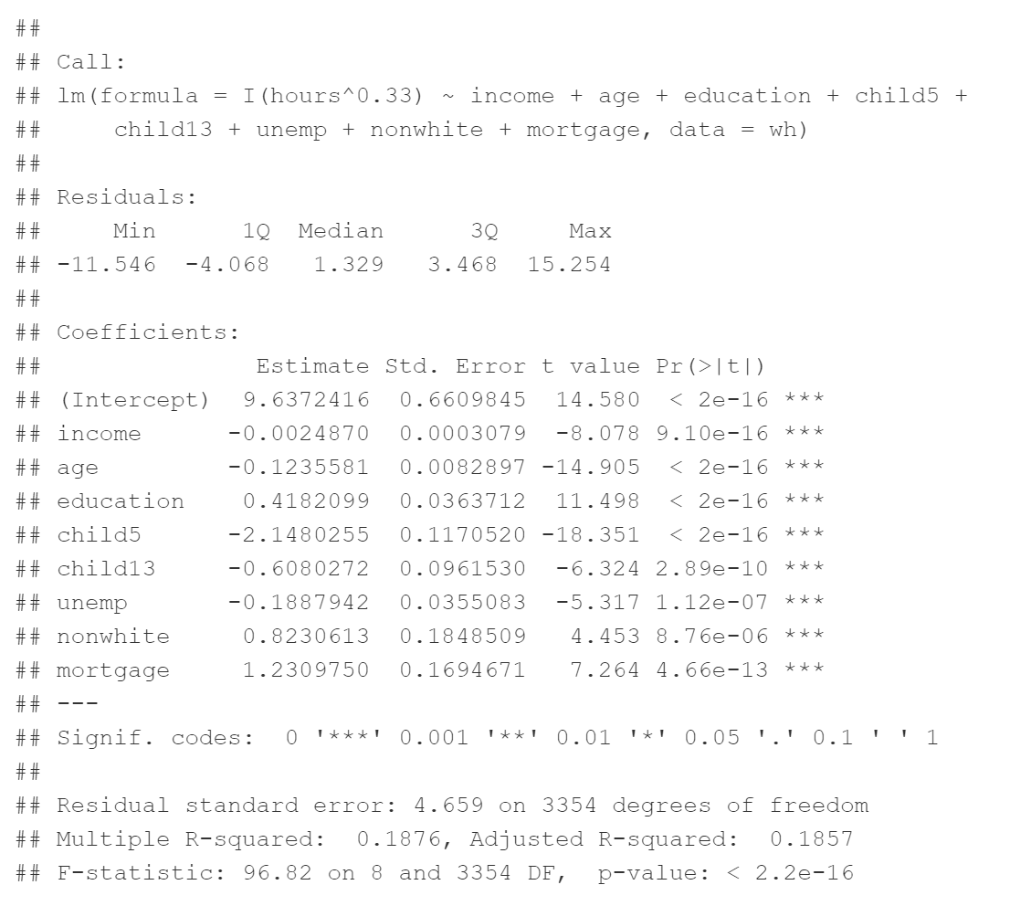
Transformation Process Cont.
Delete the predictors: child17, owned and occupation
Compare with the previous model
Interpretation

Slide 21
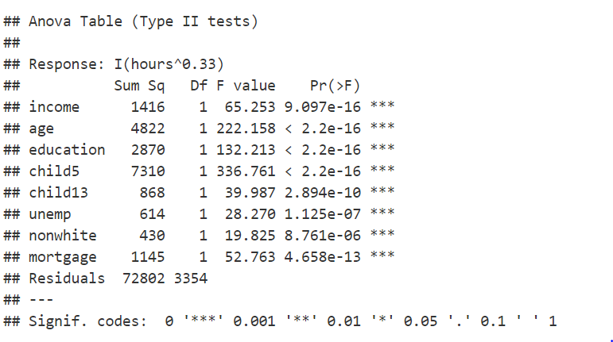
Transformation Process Cont.
Small P-value
Reject NH for all the predictors
Apply the transformation

Slide 22
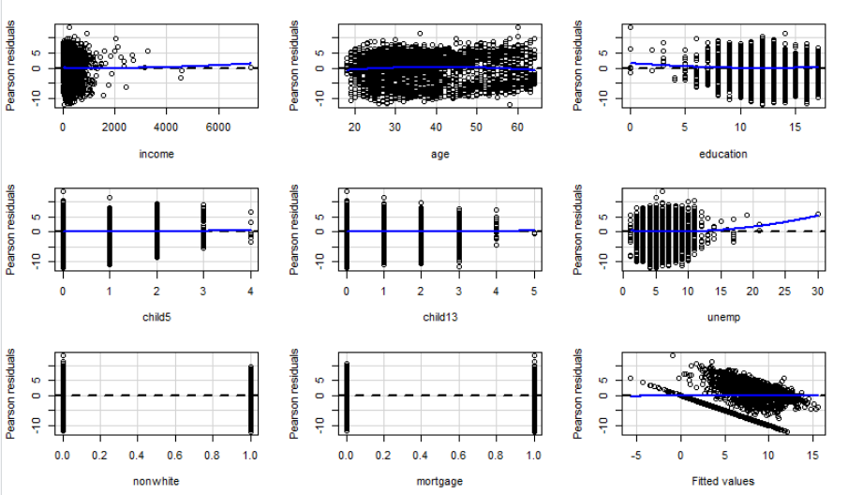
Transformation Process Cont.

Slide 23
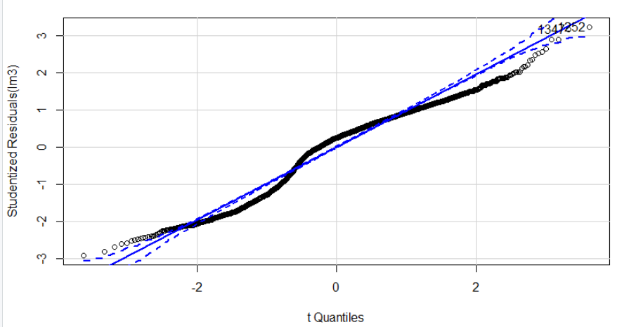
Transformation Process Cont.

Slide 24
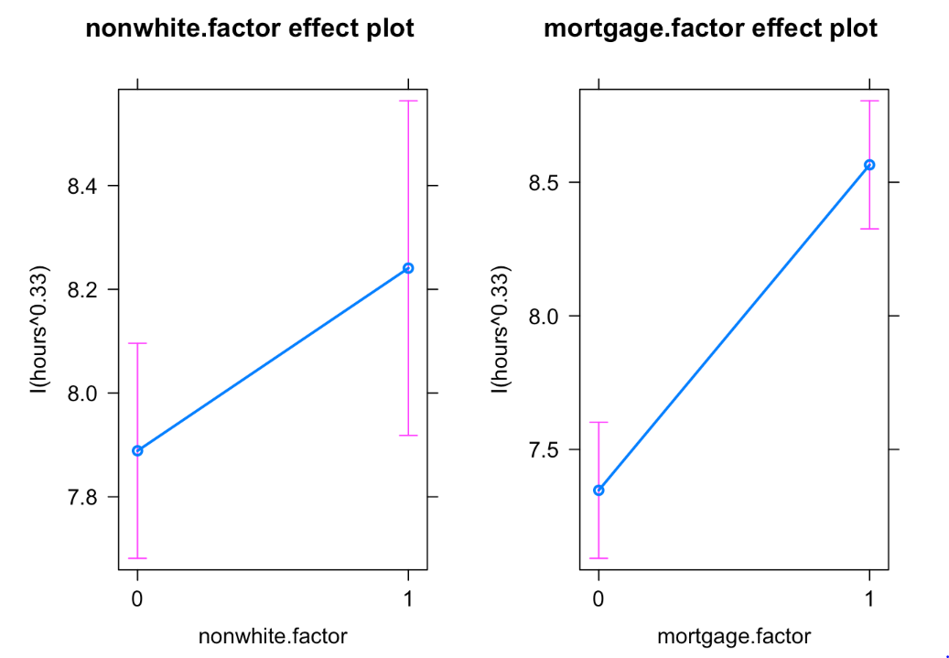
Main Effect Plot-Races and Housing Situation
Nonwhite has longer working hours
Women with mortgage will work longer than those without mortgage

Slide 25
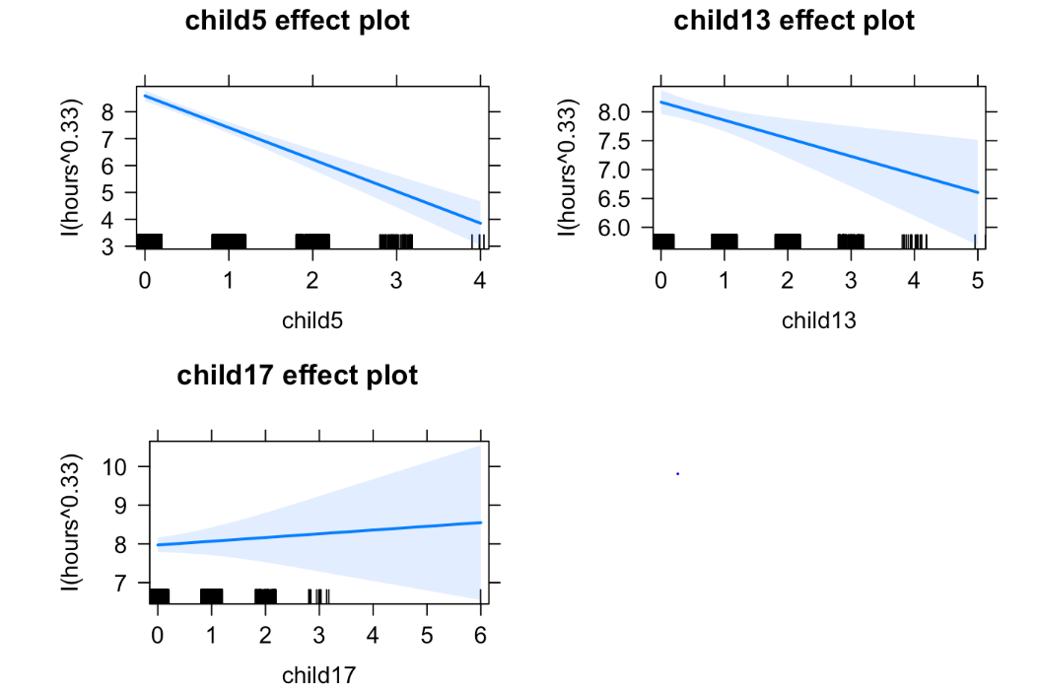
Main Effect Plot-Children factor
Strong relationship between the number of children and the working hours of women

Slide 26
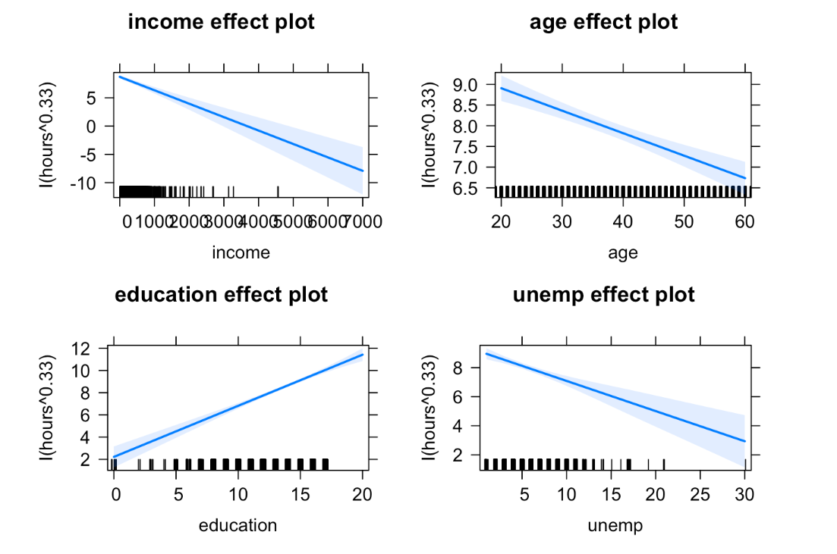
Main Effect Plot-Other Four Factors

Slide 27
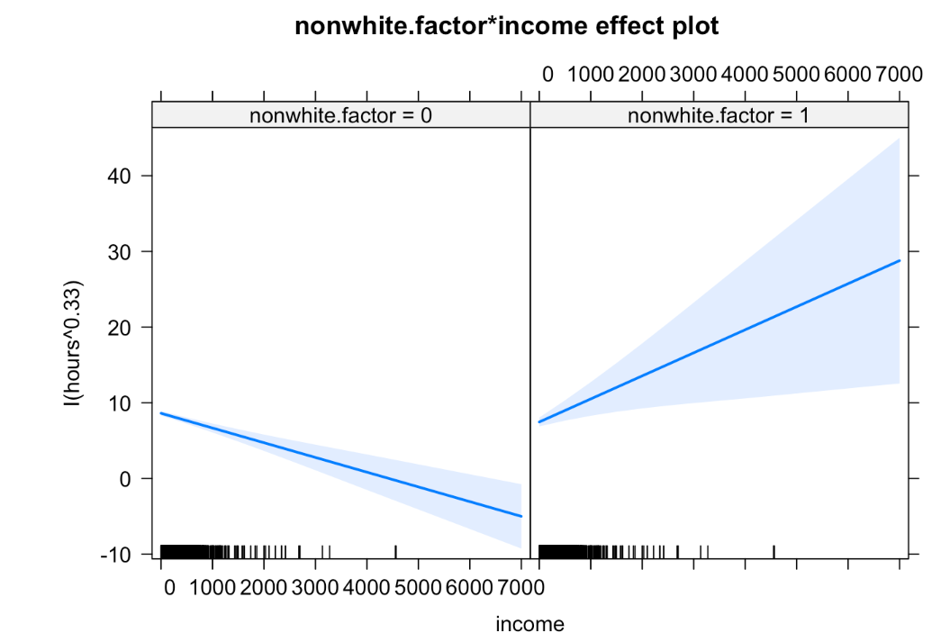
Main Effect Plot-Nonwhite and Income interaction
Non-white and income interation
Non-white: higher income of their husband, longer working hours
White: higher income of their husband, shorter working hours

Slide 28
The Testing Process
Segment the data into two parts: Model Building Part and Test Part
Calculate predicted response based on the model
Calculate R-squared to see how the model does

Slide 29
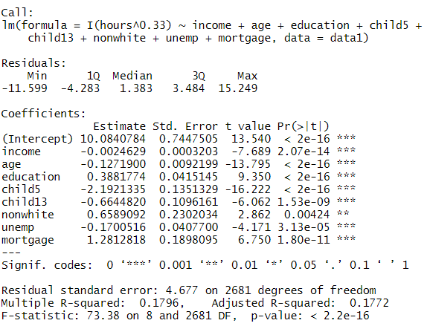
Testing Process
Segment the data into two parts
Model building part: 80% of data set
Testing part: 20% of data set

Slide 30
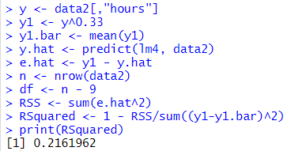
Testing Process Cont.
Applied model using 20% of the data set
R-squared: 0.216
Concluded that model predicts 21.6% of reason behind the women working hours

Slide 31
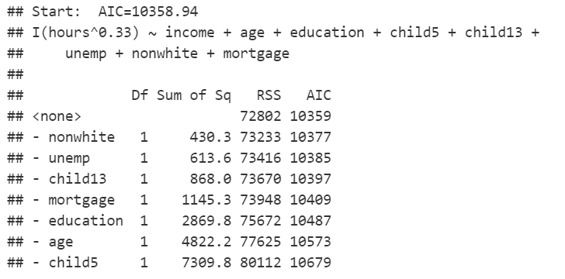
Discovery of Active Predictors
We also applied forward addition method and the result is the same as “backward elimination”

Slide 32
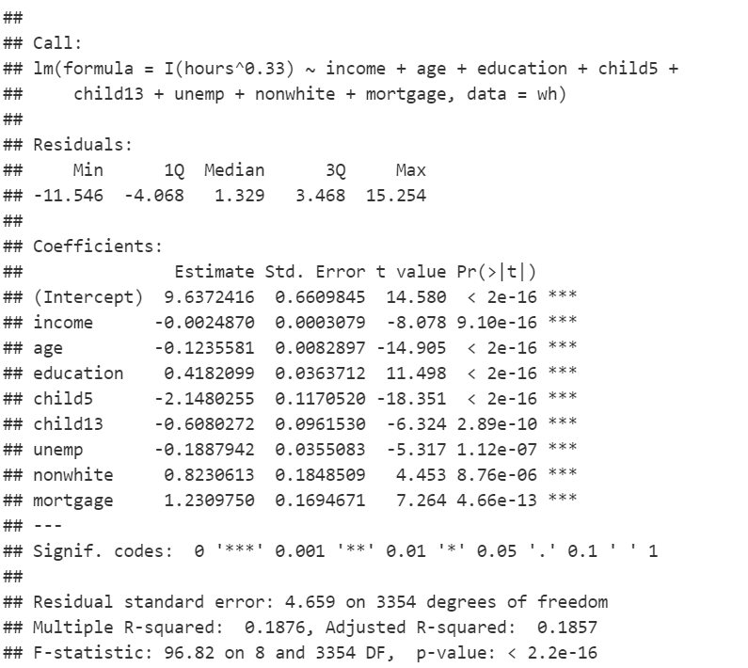
Discovery of Active Predictors
All the predictors are active

Slide 33
Key Insights
1 Other household’s income, housing situation, number of young children, education and race difference have a relationship with women’s working hours
2 Different races of wives have opposite response on higher income that their husbands earned
3 In terms of children factor, the main effect on wife’s working hours comes from the number of children who are below 13 years old
4 There are still many other reasons behind wife’s working hours in different families

Slide 34
Thank You
Any Quesions?

